Slide 1
Chapter 11
What Works and What Doesn’t

Slide 2
Are Hospitals Good for You?
From Angrist and Pischke, Mostly Harmless Econometrics

Slide 3
What Is a Treatment Effect?

Slide 4
What Can We See?
What the outcome is with the treatment
The outcome for others who were not treated
In our hospital example, the second may be different kinds of people!

Slide 5
The Selection Problem (you can’t see what didn’t happen)
This is ρ
<0 in our hospital example (why?)

Slide 6
Randomized Experiments
Randomization makes getting the treatment independent of what Y_{0i} is
It’s like randomly sending some people to hospital and others not, then comparing their health afterwards
This makes…

Slide 7
Mexico’s PROGRESA Program (Now OPORTUNIDADES)
In 1997, poor countries didn’t have major protection programs for the rural poor
Many had social security and medical insurance
  but only for formal-sector (mostly urban) workers
Radical new idea: Hand money to poor people
  Mostly women
  Conditional on kids in school and clinics

Slide 8
A Social Experiment
Impossible to launch full program at once
Rolled out to randomly chosen villages
Looked like a drug trial
  (without the placebo)
Baseline surveys of everyone determined eligibility
After a year, see what happens
A near-perfect randomized experiment!

Slide 9
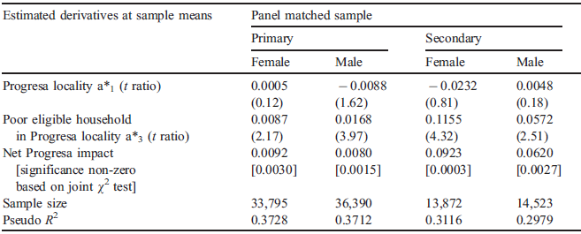
A Classic PROGRESA Study
Enrollment in school of kid i at time t (S_{it}=1 if enrolled, 0 otherwise; P_{i}=1 if a PROGRESA village; E_{i}=1 if household is eligible for PROGRESA):
Really Shouldn’t Matter
P_{i}: Kid i in randomly assigned PROGRESA village; E_{i}: eligibility dummy
T. Paul Schultz. 2004. School Subsidies for the Poor: Evaluating the Mexican PROGRESA Poverty Program. Journal of Development Economics 74(199-250).

Slide 10
“The World Bank is finally embracing science.”
“Creating a culture in which rigorous randomized evaluations are promoted, encouraged, and financed has the potential to revolutionize social policy during the 21st century, just as randomized trials revolutionized medicine during the 20th.”
-Esther Duflo

Slide 11
Social Cash Transfers in Africa
Malawi: reduction in child morbidity, gains in school enrolment, increases in food consumption, decrease in child labor
Ethiopia: increase in school attendance for some groups, particularly younger children; reduction in male child labor
South Africa: increased school attendance, decreased hunger, increased access to cell-phone use and AIDS among school-age girls

Slide 12
Other Examples of Randomized Control Trials (Chapter 11)
Hope
AIDS
Vaccines (The Last Mile)
Worms
Credit
Insurance

Slide 13
The Skeptic
“In ideal circumstances, randomized evaluations of projects are useful for obtaining a convincing estimate of the average effect of a program or project.
The price for this success is a focus that is too narrow to tell us “what works” in development, to design policy, or to advance scientific knowledge about development processes.”
-Angus Deaton

Slide 14
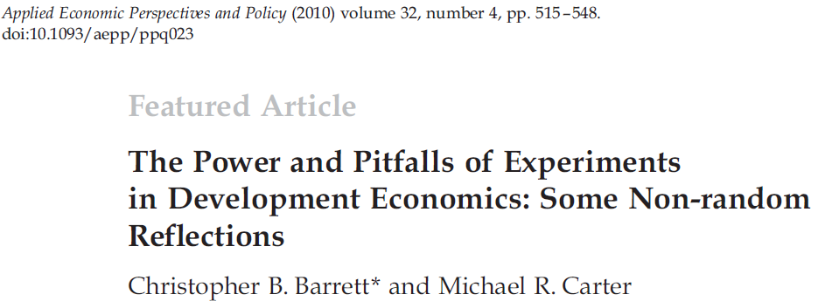
The Ethics of Randomized Control Trials

Slide 15
1. Do No Harm?
Gugerty and Kremer (2008) tests whether grants of money to women’s organizations in Kenya distorts them and leads to the exclusion of poorer women and their loss of benefits (Answer: yes. Experiment arguably hurt poor women to show this.)
Randomly giving loans to people who don’t qualify

Slide 16
2. Informed Consent
Individuals are often unaware that they are (or are not) part of an experiment
Biomedical researchers have given this issue much thought, but development economists less so

Slide 17
3. Unblindedness
Those who know themselves to be in a control group may suffer emotional distress
  …which can have adverse biophysical consequences that exaggerate the differences between control and treatment groups
But does blindedness make sense in economic experiments?

Slide 18
4. The Ethics of Not Targeting
Randomized interventions treat individuals who don’t need the treatment
  …wasting scarce resources
  …and encouraging project implementers to violate the randomized research design
This raises ethical questions and makes it hard to keep the experiment “clean”
  It’s easy to lose control of the experiment

Slide 19
“Which of the eligible households do you want to kill?”
-Minister of Gender, Children and Community Development

Slide 20
Other Problems
Just because a treatment is beneficial doesn’t mean it’s the best way to do something
…or that it will have the same benefits once you “ramp it up,” say, to all villages
Increasingly, people want to know the total impact, not just the “average effect of the treatment on the treated.”

